Slide 1
ROUTING AND SWITCHING
Lesson Three
https://networklessons.com/cisco/ccna-routing-switching-icnd1-100-105/tcpip-stack-tutorial

Slide 2
UNIT ONE: NETWORK FUNDAMENTALS
TCP/IP Stack
Besides the OSI model there was another organization that created a similar reference model which never became quite as popular.

Slide 3
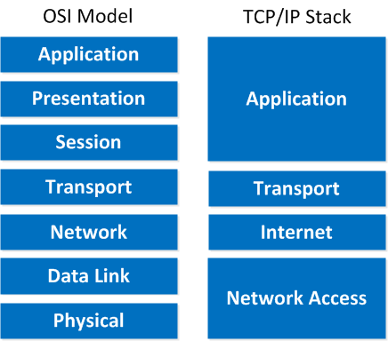
UNIT ONE: NETWORK FUNDAMENTALS

Slide 4
UNIT ONE: NETWORK FUNDAMENTALS
Internet Protocol Version 4 (IPv4) (https://networklessons.com/cisco/ccna-routing-switching-icnd1-100-105/internet-protocol)
IP uses Packets called IP packets to carry information.
Every IP packet is a single unit of information and besides data it carries information to determine where to send the packet.
IP determines where to send packets to by looking at the destination IP address.

Slide 5
UNIT ONE: NETWORK FUNDAMENTALS
Internet Protocol Version 4 (IPv4) (https://networklessons.com/cisco/ccna-routing-switching-icnd1-100-105/internet-protocol)
Characteristic of IPv4
Operates at the network layer of the OSI model.
Connectionless protocol: IP itself does not setup a connection, in order to transport data you need the “transport” layer and use TCP or UDP.
Every packet is treated independently; there is no order in which the packets are arriving at their destination.
Hierarchical: IP addresses have a hierarchy; we‟ll discuss this a bit more in depth when we talk about subnetting and subnet masks.

Slide 6
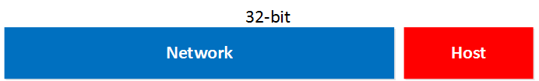
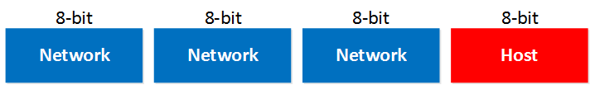
UNIT ONE: NETWORK FUNDAMENTALS
Internet Protocol Version 4 (IPv4) (https://networklessons.com/cisco/ccna-routing-switching-icnd1-100-105/internet-protocol)
Parts of IPv4
An IP address is 32-bit and consists of 2 parts, the network part and the host part:

Slide 7
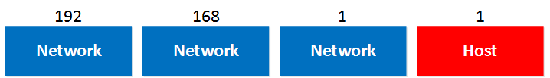
UNIT ONE: NETWORK FUNDAMENTALS
Internet Protocol Version 4 (IPv4) (https://networklessons.com/cisco/ccna-routing-switching-icnd1-100-105/internet-protocol)
Parts of IPv4
You probably have seen the IP address 192.168.1.1 before. It’s a very commonly used IP address on local networks. For this IP address the first 3 bytes are the “network” address and the last byte is the “host” address:
why are the first 3 bytes the “network” part and why is the last byte the “host” part?
We only gave the IP address but you might remember that if you configure an IP address you also have to specify the subnet mask.
Our IP address 192.168.1.1 would come along with the subnet mask 255.255.255.0.

Slide 8
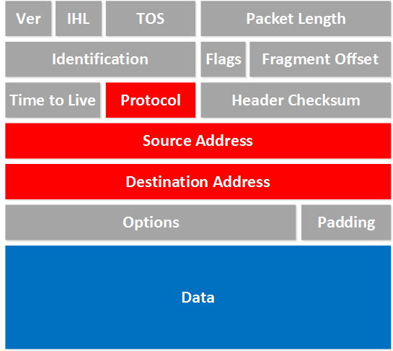
UNIT ONE: NETWORK FUNDAMENTALS
Internet Protocol Version 4 (IPv4) (https://networklessons.com/cisco/ccna-routing-switching-icnd1-100-105/internet-protocol)
Parts of IPv4
Protocol: Here you will find which protocol we are using on top of IP, this is how we specify which
transport layer protocol we are using. So you’ll find TCP, UDP or perhaps something else in here.
Source Address: Here you will find the IP address of the device that created this IP packet.
Destination Address: This is the IP address of the device that should receive the IP packet.
Data: this is the actual data that we are trying to get to the other side.

Slide 9
UNIT ONE: NETWORK FUNDAMENTALS
Internet Protocol Version 4 (IPv4) (https://networklessons.com/cisco/ccna-routing-switching-icnd1-100-105/internet-protocol)
Parts of IPv4
Let’s take another look at an IP address:
192.168.1.1

Slide 10
UNIT ONE: NETWORK FUNDAMENTALS
Internet Protocol Version 4 (IPv4) (https://networklessons.com/cisco/ccna-routing-switching-icnd1-100-105/internet-protocol)
Parts of IPv4
There are have 3 different classes to work with:
Class A
Class B
Class C
So what’s the difference between them? The difference between them is how many hosts you can fit in each network, let me show you an example:

Slide 11
UNIT ONE: NETWORK FUNDAMENTALS
Internet Protocol Version 4 (IPv4) (https://networklessons.com/cisco/ccna-routing-switching-icnd1-100-105/internet-protocol)
Parts of IPv4

Slide 12
UNIT ONE: NETWORK FUNDAMENTALS
Internet Protocol Version 4 (IPv4) (https://networklessons.com/cisco/ccna-routing-switching-icnd1-100-105/internet-protocol)
Parts of IPv4
Class A: The first bit always has to be 0.
Class B: The first 2 bits always have to be 10.
Class C: The first 3 bits always have to be 110.
So what are the exact ranges that we have?
Class A: 0.0.0.0 – 126.255.255.255
Class B: 128.0.0.0 – 191.255.255.255
Class C: 192.0.0.0 – 223.255.255.25

